Slide 1
HARNEY SOIL AND WATER CONSERVATION DISTRICT
Annual Meeting 2/23/2023

Slide 2
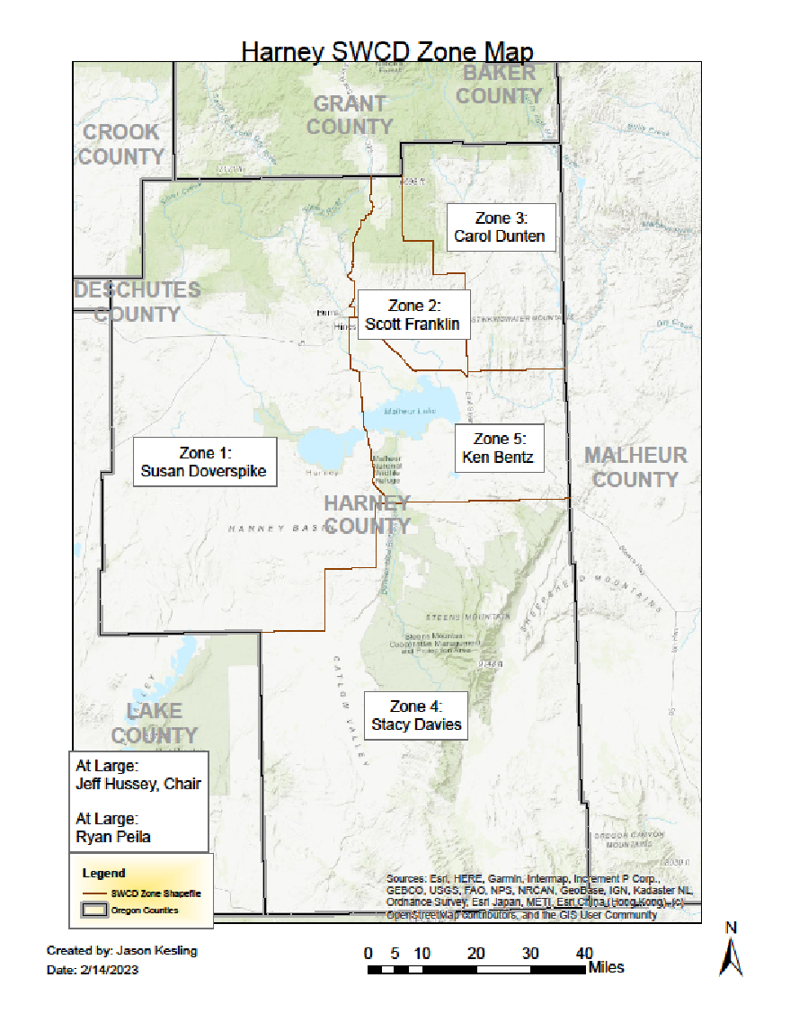
Harney SWCD Board of Directors
Zone 1: Susan Doverspike
Zone 2: Scott Franklin (Vice Chair)
Zone 3: Carol Dunten
Zone 4: Stacy Davies
Zone 5: Ken Bentz
At large 1: Ryan Peila (Sec/Treas)
At Large 2: Jeff Hussey (Chair)

Slide 3
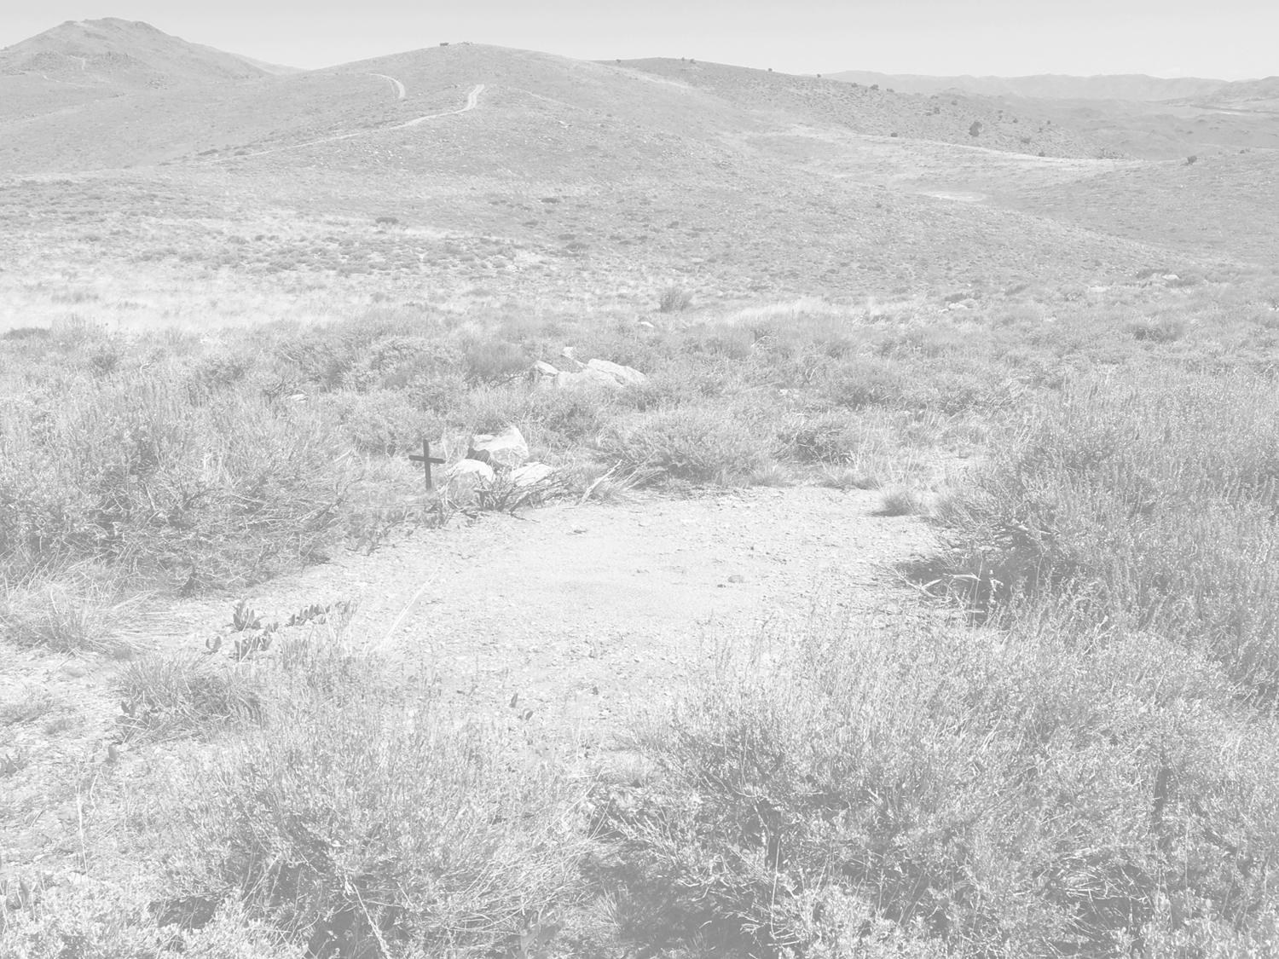
STAFF
Jason Kesling, District Manager
Barbara Pearson, Administration Assistant
Sarah Mundy, CCAA Coordinator
Danielle Reynolds, NRCS Partner Biologist
Tyler Goss, Harney CWMA Coordinator
Sam Artaiz, SONEC Partner Biologist
Breanna O’Connor, CCAA/Ag Water Specialist

Slide 4
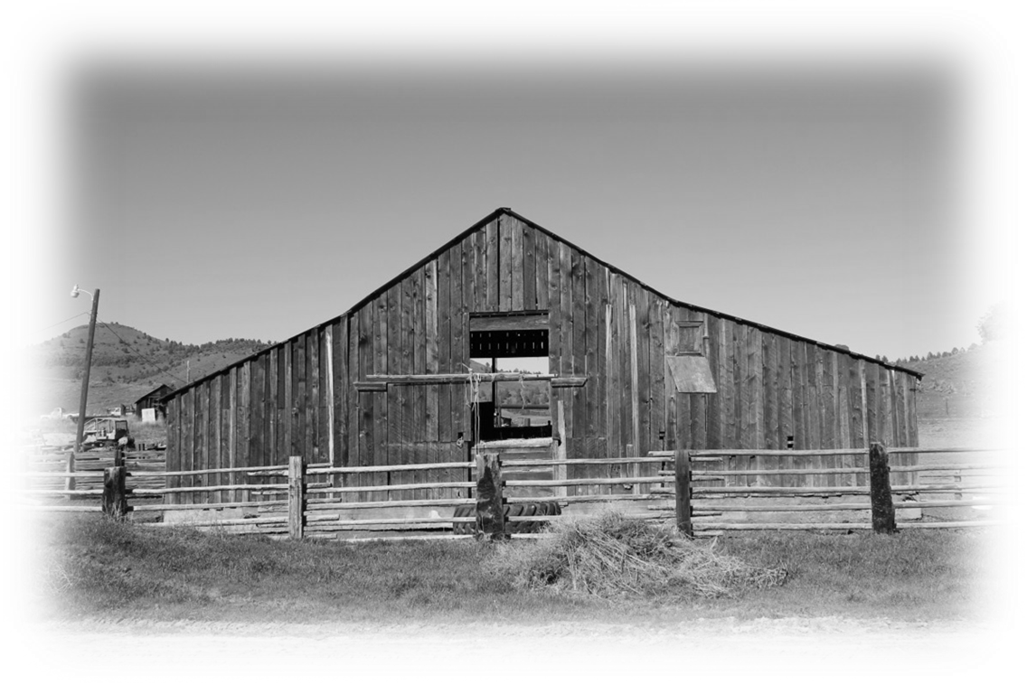
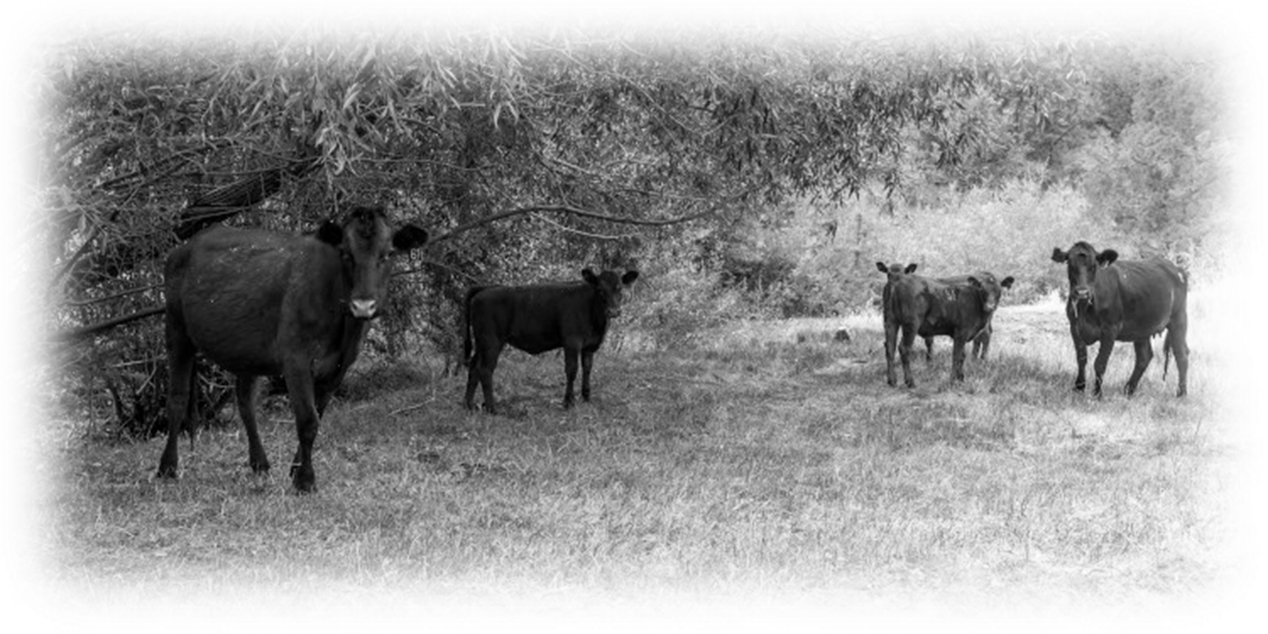
MISSION
To conserve, protect and enhance natural resources for the social, economic, and environmental benefit of the people of Harney County.

Slide 5
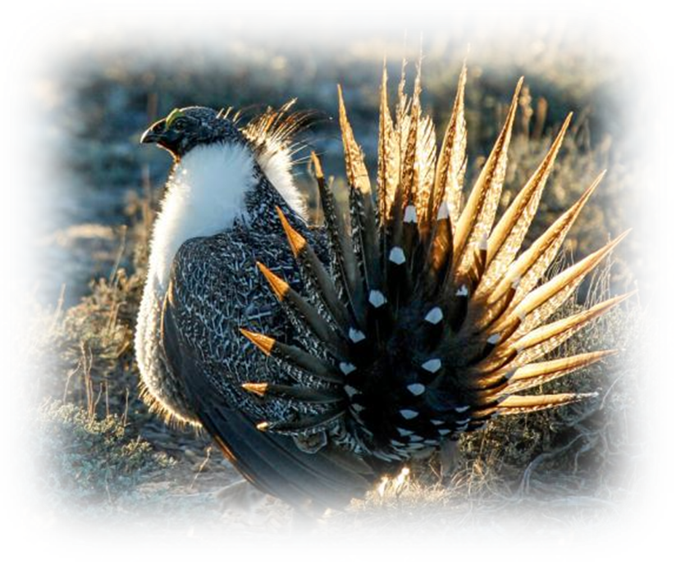
Current Programs
Sage grouse Candidate Conservation Agreement with Assurances (CCAA)
SONEC Wetlands (Southern Oregon/Northeastern California)
Harney Cooperative Weed Management Area (CWMA)
Groundwater Outreach Programs
OWEB Small Grants
Range Drill Rental
Solar Trailers Rental
Silvies River Focus Area (ODA)

Slide 6

PRIORITY AREAS
Range Health
Forest Health
Ecosystem Health
Ag Water Quality
Ag Energy
  Juniper Encroachment
  Invasive Species
  Grazing management
  Coordinated landscape resource management
  Complement NRCS sage grouse Initiative (SGI)
  Precommercial thinning
  Portable solar watering systems for permitees
  Fuels reduction
  HCRC participation
  Landscape resource management
  Greater sage grouse Candidate Conservation Agreement w/Assurances (CCAA) outreach & site specific plan development
  Basin carp removal
  Invasive species
  Development of outreach strategy within the Silvies River Demonstration Area
  Maintain or improve stream bank vegetation based on site potential and other factors
  Reducing energy demand on Harney Electric by improving irrigation efficiency through installing new technology
  Solar livestock watering systems: portable & fixed

Slide 7
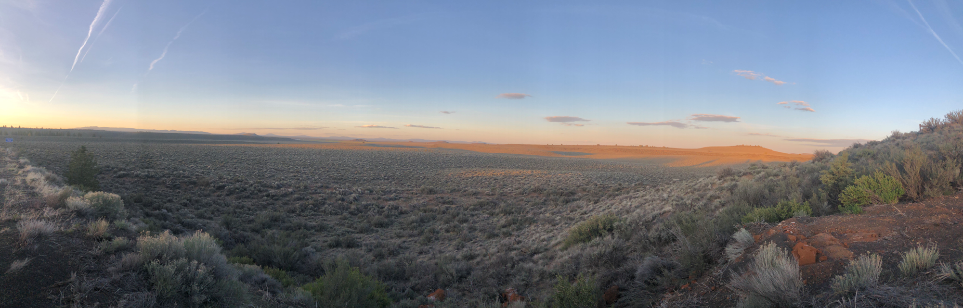
Snapshot of 2022

Slide 8
2022 Accomplishments
Secured Funding
Sage Grouse RCPP ($3,292,207.62)
Renewal of Stinkingwater RCPP ($960,000)
SOWR Weed and Juniper Treatment ($1,491,728)
  Juniper 837.7 acres completed & 3,237 proposed
  Weed 13,500 acres in progress
OWEB
  Technical Assistance for SG ($75,000)
  Monitoring for SG ($153,384),
  Baker Corral ($199,387),
  9 Small grants ($100,000)
USFWS Pepperweed Treatment ($50,000)
USFWS Infrastructure Bill Money ($100,000)
CWMA Title II ($234,000)
New Positions
Added two new positions
  NRCS SG Partner Biologist
  CCAA/Ag Water Specialist
Improvements
Purchased New Pickup and Range Drill Trailer
Repaired Range Drills
CWMA Purchased Drone, Training for operator
Other
CCAA Video (All Counties, USFWS, SageCon)
Submitted FEMA BRIC Grant
  12 Ranches ($4,922,101.80)

Slide 9
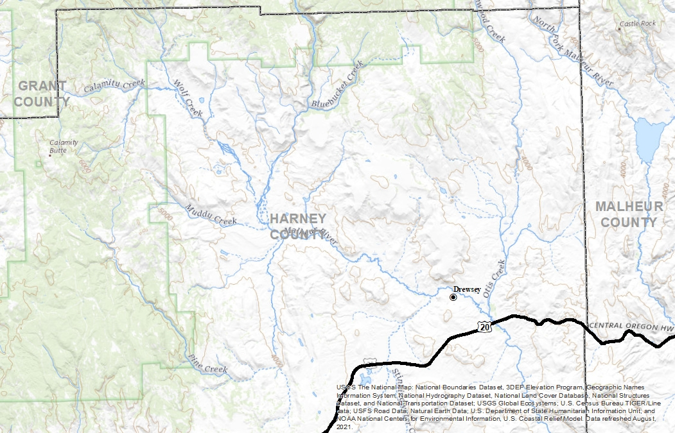
Drewsey Area
Programs for assistance
  Title 2 (weeds)
  Forest Fringe (NRCS)
  NRCS SGI
  OWEB Large Grants
  SIA
  Proposed HB 3142 (high priority area)
  Proposed Joint Chiefs

Slide 10
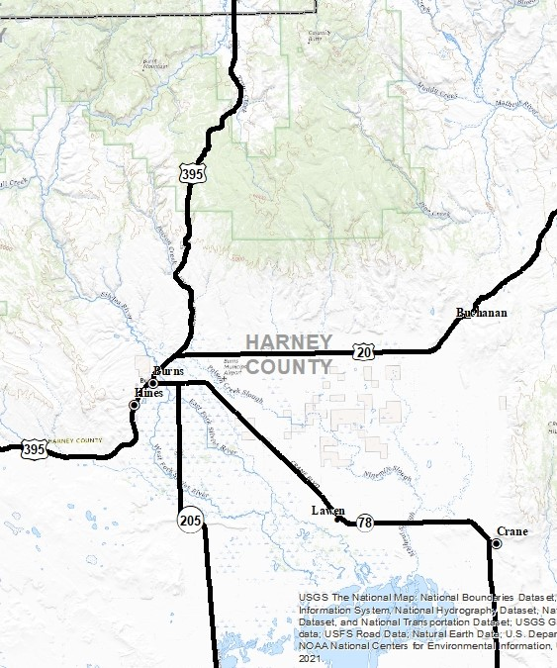
Harney Basin
Programs for assistance
  Title 2 (Weeds)
  Forest Fringe (NRCS)
  OWEB Small Grant
  OWEB Large Grant
  SONEC
  NRCS SGI
  NRCS Groundwater
  Proposed HB 3142 (low priority area)
  Proposed Joint Chiefs

Slide 11
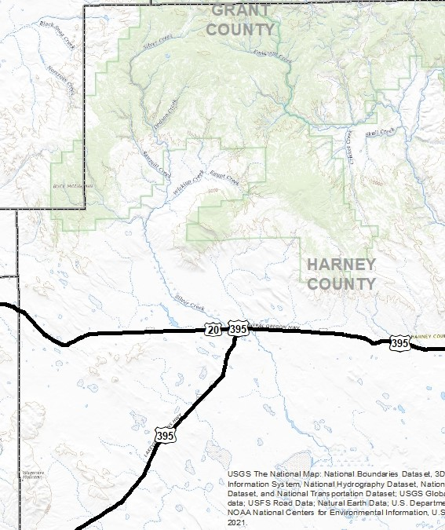
Riley Area
Programs for assistance
  Title 2 (Weeds)
  Forest Fringe (NRCS)
  OWEB Small Grant
  OWEB Large Grant
  SONEC
  NRCS SGI
  NRCS Groundwater
  Proposed HB 3142 (Medium priority area)

Slide 12
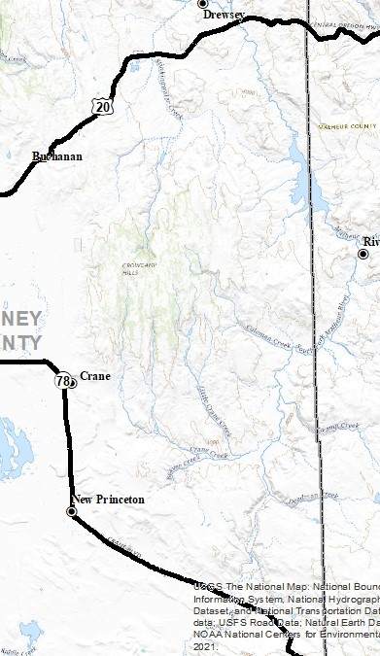
Stinkingwater Area
Programs for assistance
  Stinkingwater RCPP
  Sage Grouse RCPP
  OWEB Small Grants
  OWEB Large Grants
  NRCS SGI
  Proposed FIP 3.0 for SG

Slide 13
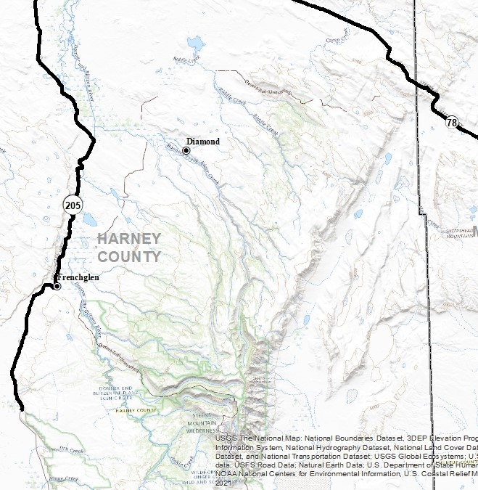
Steens Area
Programs for assistance
  Sage Grouse RCPP
  OWEB Small Grant
  OWEB Large Grant
  NRCS SGI
  Proposed FIP 3.0 for SG

Slide 14
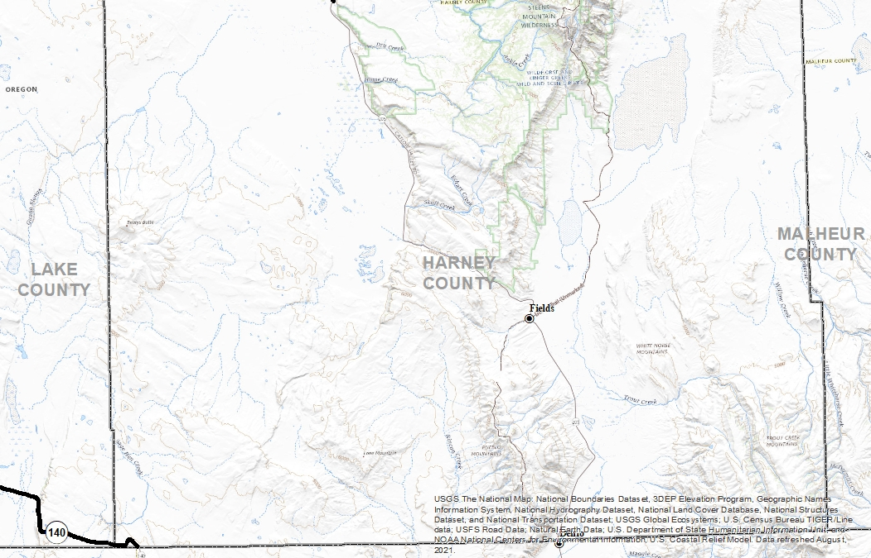
Fields/South County
Programs for assistance
  NRCS SGI
  OWEB Small Grants
  OWEB Large Grants
  Proposed FIP 3.0 for SG

Slide 15
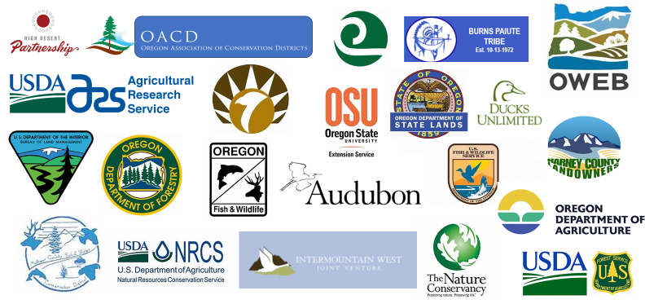
Partnership and Collaboration

